Slide 1
Python Atlanta Meetup Python In Security
May 9, 2019
Jonathan Glass, Cloud Security

Slide 2

Who Am I?
Information Security Professional
Cloud, Automation, & Programming Polyglot
Projects Highlights
Cloud Security assessment automation using Python
Cloud deployment automation with Python and Terraform
Using Google Vision API and AWS Rekognition to detect text in pictures for several projects
Created an evidence collection system that led to multiple terrorism convictions
Created an F5 ASM (WAF) replacement using AWS WAF + DynamoDB, Edge Lambdas (Node), and standard Lambdas (Python). Reduced time to detect and block threats from 5+ minutes to <5 seconds.

Slide 3
TWO parallel Topics for tonight’s presentation
Python Insecurity: Python Code Vulnerabilities & Remediations
Python in Security: Python Tools Used in Information Security

Slide 4
Recognizing and Fixing Common Software Vulnerabilities in Python
Python insecurity

Slide 5
OWASP Top 10
Python Coding Vulnerability Example: Injection / Unchecked Input
Python INSecurity outline
A1:2017-Injection
Use Pipenv and/or Safety to check your modules
A9:2017-Using Components with Known Vulnerabilities
Python security checklist from snyk.io

Slide 6
OWASP Top 10 Application Security Risks - 2017
A1:2017-Injection
Injection flaws, such as SQL, NoSQL, OS, and LDAP injection, occur when untrusted data is sent to an interpreter as part of a command or query. The attacker's hostile data can trick the interpreter into executing unintended commands or accessing data without proper authorization.
A2:2017-Broken Authentication
Application functions related to authentication and session management are often implemented incorrectly, allowing attackers to compromise passwords, keys, or session tokens, or to exploit other implementation flaws to assume other users' identities temporarily or permanently.
A3:2017-Sensitive Data Exposure
Many web applications and APIs do not properly protect sensitive data, such as financial, healthcare, and PII. Attackers may steal or modify such weakly protected data to conduct credit card fraud, identity theft, or other crimes. Sensitive data may be compromised without extra protection, such as encryption at rest or in transit, and requires special precautions when exchanged with the browser.
A4:2017-XML External Entities (XXE)
Many older or poorly configured XML processors evaluate external entity references within XML documents. External entities can be used to disclose internal files using the file URI handler, internal file shares, internal port scanning, remote code execution, and denial of service attacks.
A5:2017-Broken Access Control
Restrictions on what authenticated users are allowed to do are often not properly enforced. Attackers can exploit these flaws to access unauthorized functionality and/or data, such as access other users' accounts, view sensitive files, modify other users' data, change access rights, etc.
https://www.owasp.org/index.php/Top_10-2017_Top_10

Slide 7
OWASP Top 10 Application Security Risks - 2017
A6:2017-Security Misconfiguration
Security misconfiguration is the most commonly seen issue. This is commonly a result of insecure default configurations, incomplete or ad hoc configurations, open cloud storage, misconfigured HTTP headers, and verbose error messages containing sensitive information. Not only must all operating systems, frameworks, libraries, and applications be securely configured, but they must be patched/upgraded in a timely fashion.
A7:2017-Cross-Site Scripting (XSS)
XSS flaws occur whenever an application includes untrusted data in a new web page without proper validation or escaping, or updates an existing web page with user-supplied data using a browser API that can create HTML or JavaScript. XSS allows attackers to execute scripts in the victim's browser which can hijack user sessions, deface web sites, or redirect the user to malicious sites.
A8:2017-Insecure Deserialization
Insecure deserialization often leads to remote code execution. Even if deserialization flaws do not result in remote code execution, they can be used to perform attacks, including replay attacks, injection attacks, and privilege escalation attacks.
A9:2017-Using Components with Known Vulnerabilities
Components, such as libraries, frameworks, and other software modules, run with the same privileges as the application. If a vulnerable component is exploited, such an attack can facilitate serious data loss or server takeover. Applications and APIs using components with known vulnerabilities may undermine application defenses and enable various attacks and impacts.
A10:2017-Insufficient Logging & Monitoring
Insufficient logging and monitoring, coupled with missing or ineffective integration with incident response, allows attackers to further attack systems, maintain persistence, pivot to more systems, and tamper, extract, or destroy data. Most breach studies show time to detect a breach is over 200 days, typically detected by external parties rather than internal processes or monitoring.
https://www.owasp.org/index.php/Top_10-2017_Top_10

Slide 8
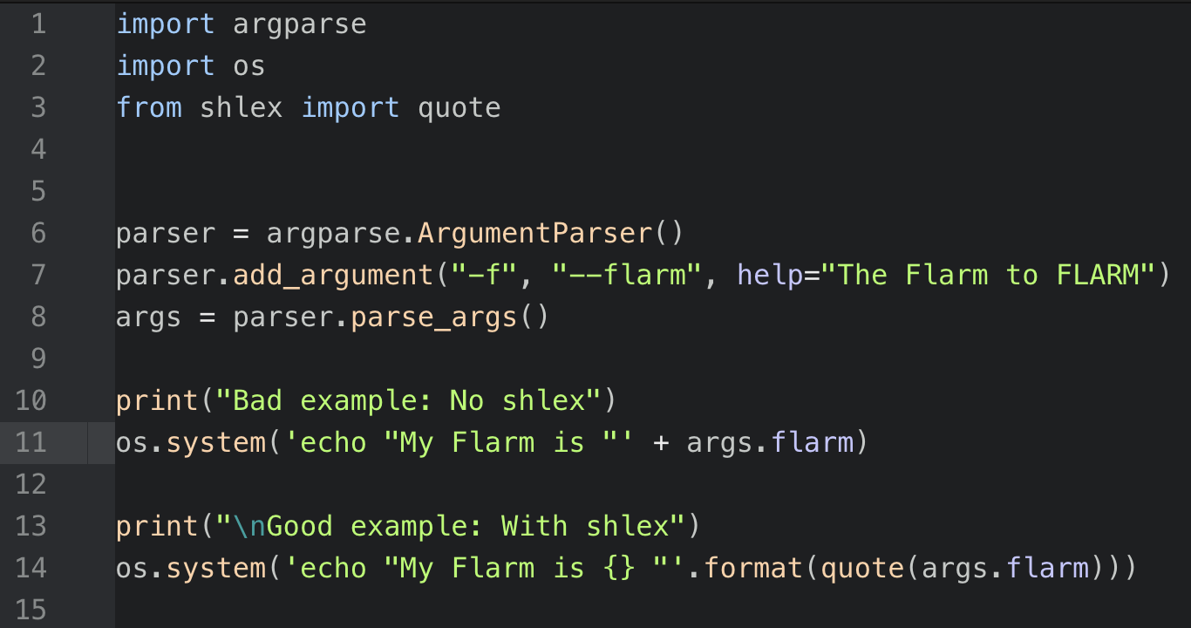
Python INSecurity – Unchecked user input
Vulnerability:
Injection via unchecked user input (command or SQLi)
Solution
Use shlex to sanitize user input before passing it to the command line

Slide 9
Python INSecurity – Unchecked user input

Slide 10
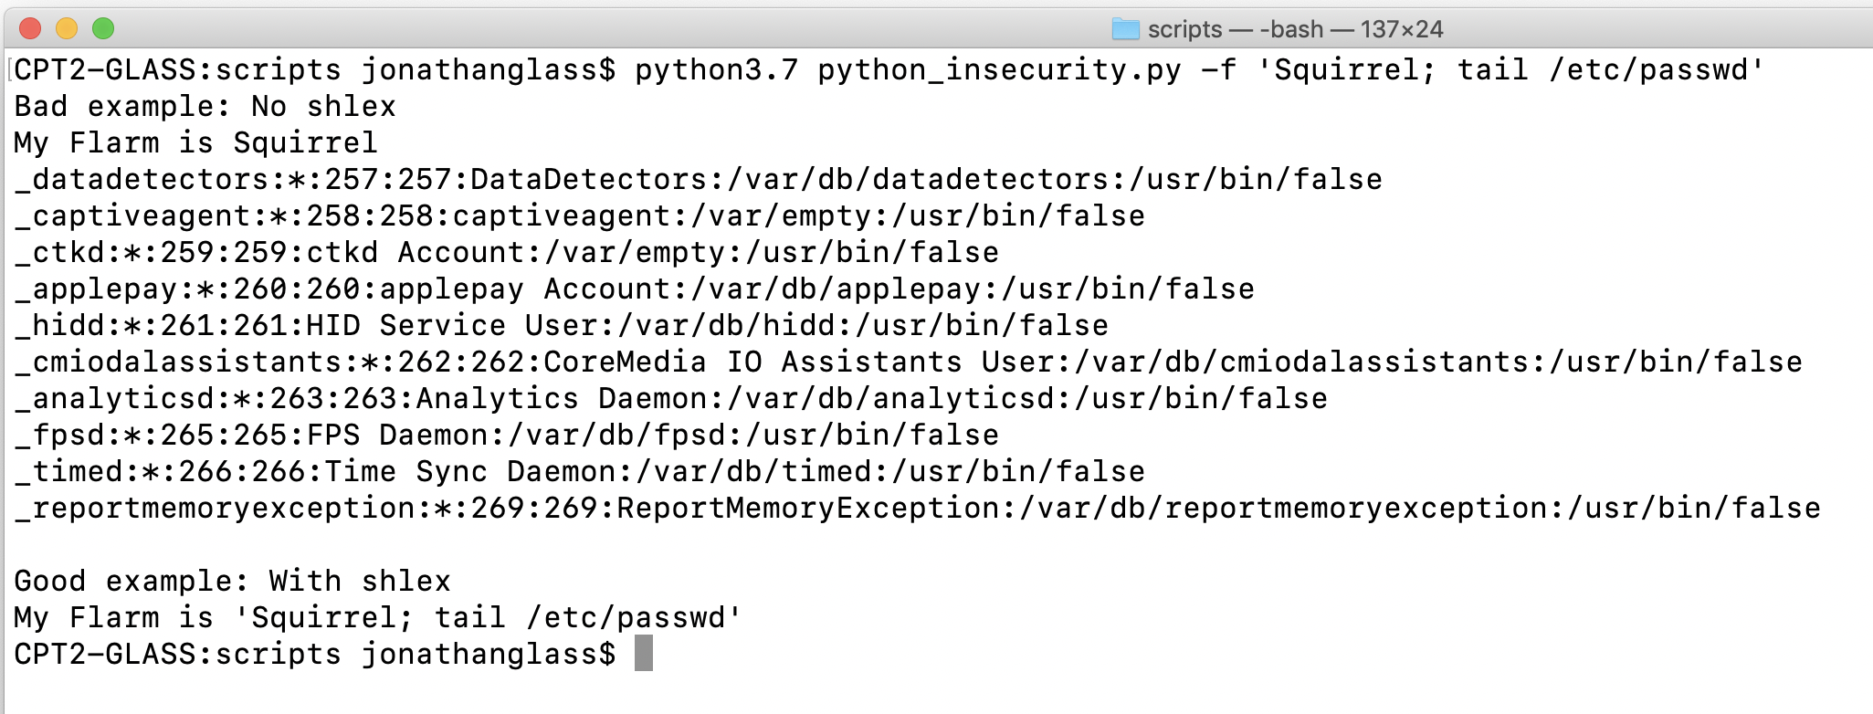
Python INSecurity – Unchecked user input
Injection via unchecked user input (command or SQLi)
Use shlex to sanitize user input before passing it to the command line

Slide 11
Code Checking - bandit
A static linter that identifies many security issues in your code
To install and run bandit, just run
‘pip install bandit’
‘bandit ./codedir’
https://pypi.org/project/bandit/
PyCQA/banditbandit - Bandit is a tool designed to find common security issues in Python code.github.com

Slide 12
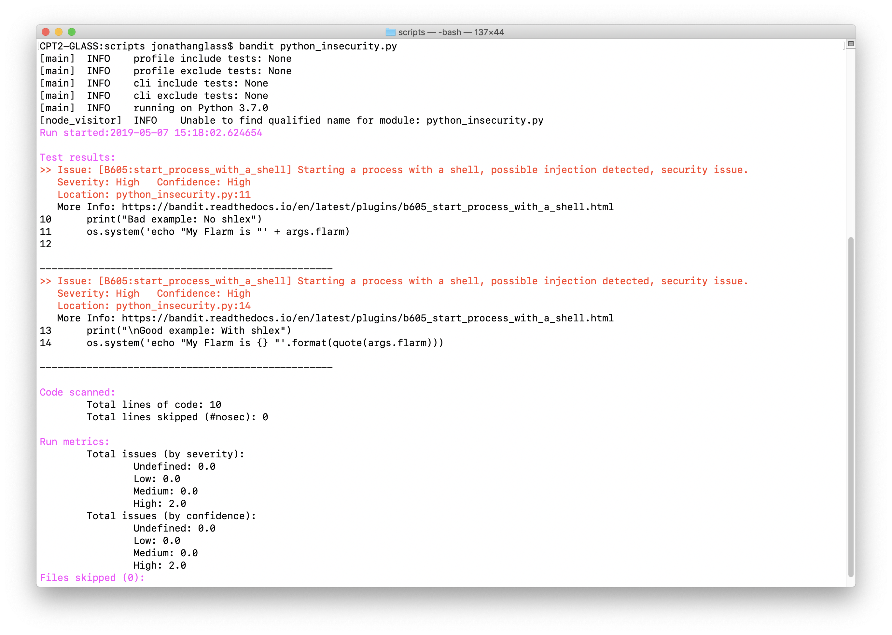
Code Checking - Bandit

Slide 13
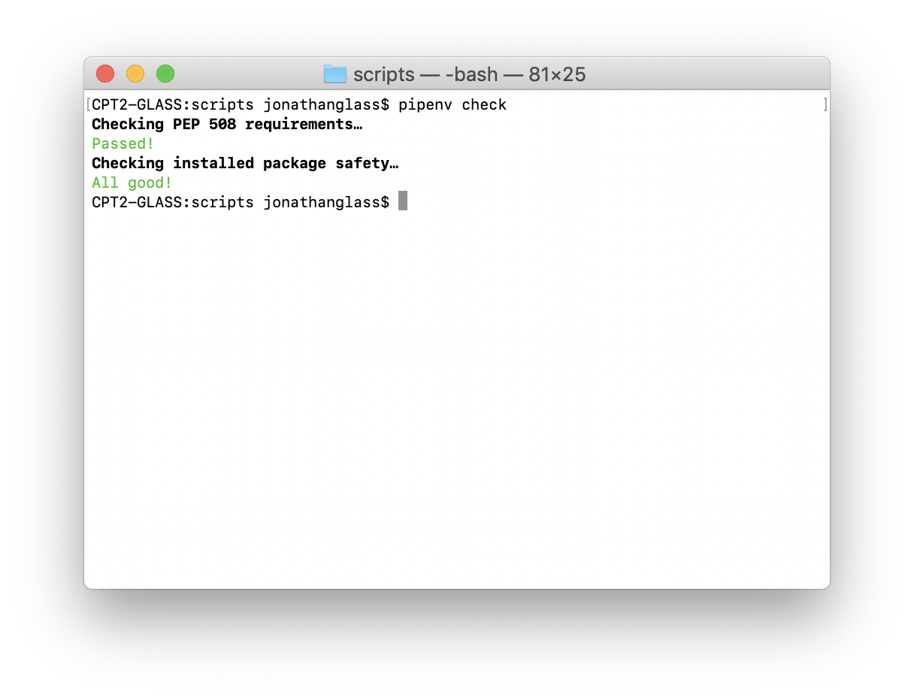
A9:2017-Using Components with Known Vulnerabilities
Tool: Pipenv
https://github.com/pypa/pipenv

Slide 14
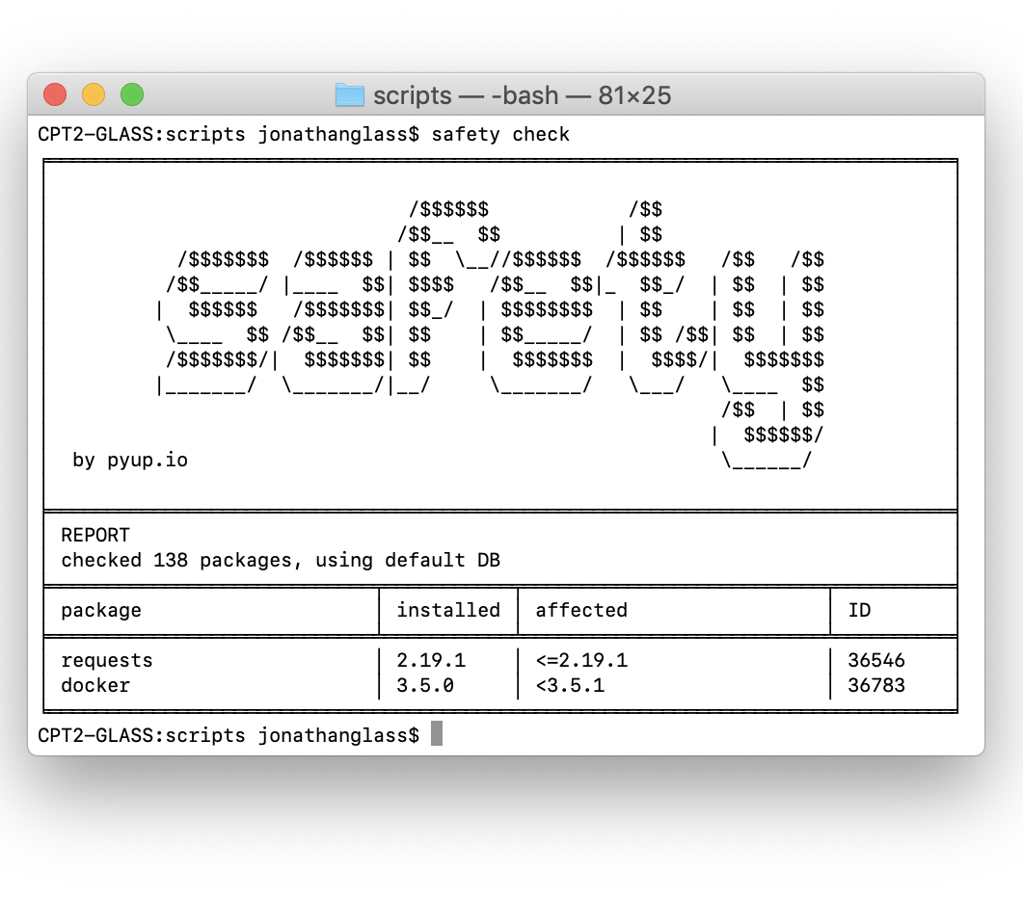
A9:2017-Using Components with Known Vulnerabilities
Tool: Safety
https://pyup.io/safety/

Slide 15
What version of Python are you using? The end of Python 2 is near—January 1, 2020. If you are using Python 2 past that date, you leave yourself open to any emerging security vulnerabilities.
Bandit is an open source security scanner for Python code. It can be run locally or as part of your CI/CD pipeline.
Python security checklist from snyk.io
Deterministic builds are important for predictable behavior in production. However, pinning your dependencies to achieve this leaves you open to security vulnerabilities. Pipenv helps you manage your environment and dependencies in a predictable, secure way.
Python import statements are flexible but can be exploited. Implicit relative imports (deprecated as of Python 3) leave your code vulnerable to malicious code execution. Whatever import method you use, remember be sure you trust the module--importing executes code!
Use Python3
Assume that there are malicious packages available on PyPI. When installing, be sure to spell the package name correctly--you don’t want to install a malicious package that is named for a common misspelling of a popular package.
Scan your code with Bandit
Use Pipenv for env & dependency
management
Watch your import statements
Download packages with care

Slide 16
Understand how the requests library utilizes certain security practices so you can get the most out of them. Keep your version of certifi up to date—the requests library uses it to verify certificates.
There are multiple ways to format strings in Python. When formatting strings from user input, extra care is needed to avoid things like injection or code execution. The Template class in the string module is a more secure way to format strings with user input
Python security checklist from snyk.io
Understand the different types of open source licenses and adhere to their terms. Be wary of any project that does not have a license; you may not like the terms of the license they eventually adopt. Over 10% of packages on PyPI fall into this category
Do not deserialize data from an untrusted source. Python’s pickle module allows for this using pickle.load. Deserializing from an untrusted source can result in arbitrary code execution.
Handle requests safely
Just because your app is secure today does not mean it will be secure tomorrow. Stay up to date on new vulnerabilities by using the Pipenv safety package
Be careful with string formatting
Review your dependency licenses
Deserialize selectively
Keep up-to-date on vulnerabilities

Slide 17
Python INSecurity Resources
https://hackernoon.com/10-common-security-gotchas-in-python-and-how-to-avoid-them-e19fbe265e03
https://snyk.io/blog/python-security-best-practices-cheat-sheet/
https://pipenv.readthedocs.io/en/latest/
https://www.owasp.org/index.php/Top_10-2017_Top_10

Slide 18
Cool Security Tools Written in Python
Python in security

Slide 19
Python In Security
I use several Open Source tools as part of my security and compliance assessments against AWS accounts.
I wanted to mention a few of these tools to highlight the flexibility of Python, and its usefulness in Security.

Slide 20
Parallel_prowler (shameless plug)
What is Prowler?
What is Parallel Prowler?
Toni Blyx’s Prowler tool that performs security and compliance checks against AWS accounts
Written in BASH, as a series of AWS CLI calls grouped into “checks”
Checks run serially
A Python wrapper for Prowler, providing
threading support
support for multiple AWS profiles by pattern
testing multiple accounts simultaneously
a combined report across all accounts
Since it’s just a wrapper, it doesn’t parallelize the individual tests
A proof of concept; if you try it, please share your feedback so I can improve it!
https://github.com/toniblyx/prowler
https://github.com/jonathanbglass/parallel_prowler

Slide 21
https://github.com/nccgroup/Scout2
Officially superseded by ScoutSuite, https://github.com/nccgroup/ScoutSuite
It works well and generates a nice report per account
Scout2 by NCC Group

Slide 22

Security Monkey by Netflix
Security Monkey monitors AWS, GCP, OpenStack, and GitHub orgs for assets and their changes over time. Built before AWS Config, which provides similar functionality.
https://github.com/Netflix/security_monkey

Slide 23
Questions?
We’re hiring!! https://www.candidpartners.com/join-us/

